Slide 1


KNN Classifier
By: Sidhidatri Nayak
CDAC,NOIDA,India

Slide 2
Notice regarding the usage of images:
This document contains images obtained by routine Google
Images searches. Some of these images may perhaps be under
copyright. They are included here for educational and
noncommercial purposes and are considered to be covered by
the doctrine of Fair Use. In any event they are easily available
from Google Images.

Slide 3
KNN Classifier
K Nearest Neighbor algorithm
Supervised Learning category
classification (most commonly) and regression.
it considers K Nearest Neighbors (Data points) to predict the class or continuous value for the new Datapoint.

Slide 4
KNN Algorithm
1. Instance-based learning: Here we do not learn weights from training data to predict output (as in model-based algorithms) but use entire training instances to predict output for unseen data.
2. Lazy Learning: Model is not learned using training data prior and the learning process is postponed to a time when prediction is requested on the new instance.
3. Non -Parametric: In KNN, there is no predefined form of the mapping function.

Slide 5
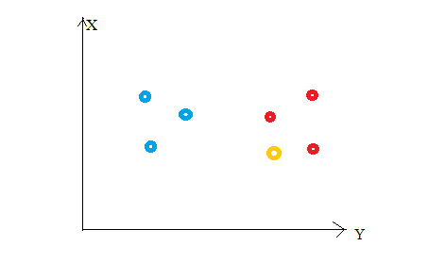
How it works ?

Slide 6
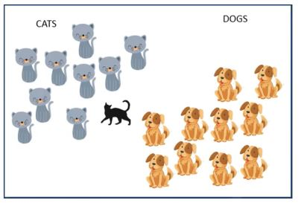
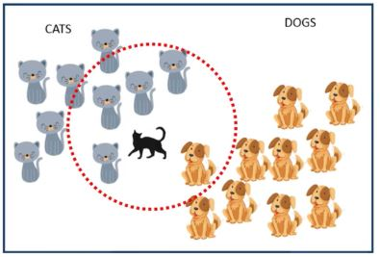
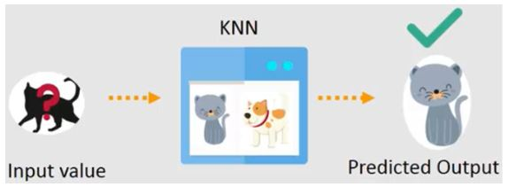
Example

Slide 7
Algorithm
Load the training data.
Prepare data by scaling, missing value treatment, and dimensionality reduction as required.
Find the optimal value for K:
Predict a class value for new data:
Calculate distance(X, Xi) from i=1,2,3,….,n. where X= new data point, Xi= training data, distance as per your chosen distance metric.
Sort these distances in increasing order with corresponding train data.
From this sorted list, select the top ‘K’ rows.
Find the most frequent class from these chosen ‘K’ rows. This will be your predicted class.

Slide 8
KNN Example
Points | X1(Acid Durability) | X2(Strength) | Y(Classification)
P1 | 7 | 7 | False
P2 | 7 | 4 | False
P3 | 3 | 4 | True
P4 | 1 | 4 | True
P5 | 3 | 7 | ?

Slide 9
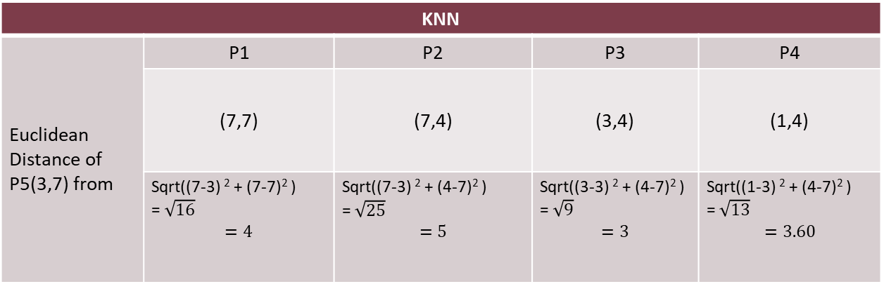
Euclidean Distance From Each Point
KNN
Euclidean Distance of P5(3,7) from | P1 | P2 | P3 | P4
 | (7,7) | (7,4) | (3,4) | (1,4)
 | Sqrt((7-3) ² + (7-7)² ) =$\sqrt{16}$ $$=4$$ | Sqrt((7-3) ² + (4-7)² ) =$\sqrt{25}$ $$=5$$ | Sqrt((3-3) ² + (4-7)² ) =$\sqrt{9}$ $$=3$$ | Sqrt((1-3) ² + (4-7)² ) =$\sqrt{13}$ $$=3.60$$

Slide 10
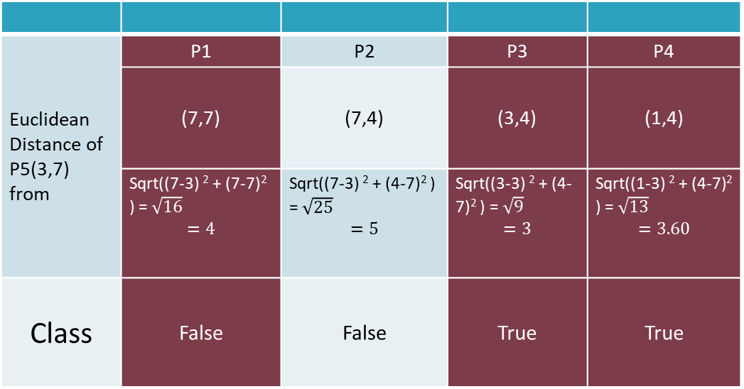
3 Nearest NeighBour
Euclidean Distance of P5(3,7) from | P1 | P2 | P3 | P4
 | (7,7) | (7,4) | (3,4) | (1,4)
 | Sqrt((7-3) ² + (7-7)² ) =$\sqrt{16}$ $$=4$$ | Sqrt((7-3) ² + (4-7)² ) =$\sqrt{25}$ $$=5$$ | Sqrt((3-3) ² + (4-7)² ) =$\sqrt{9}$ $$=3$$ | Sqrt((1-3) ² + (4-7)² ) =$\sqrt{13}$ $$=3.60$$
Class | False | False | True | True

Slide 11
KNN Classification
Points | X1(Durability) | X2(Strength) | Y(Classification)
P1 | 7 | 7 | False
P2 | 7 | 4 | False
P3 | 3 | 4 | True
P4 | 1 | 4 | True
P5 | 3 | 7 | True

Slide 12
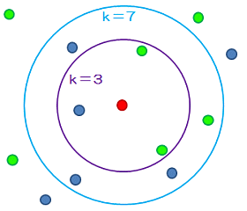
Different Values of K

Slide 13
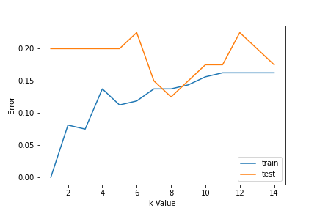
How to choose the value of K

Slide 14
Required Data Preparation:
1. Data Scaling: To locate the data point in multidimensional feature space, it would be helpful if all features are on the same scale. Hence normalization or standardization of data will help.
2. Dimensionality Reduction: KNN may not work well if there are too many features. Hence dimensionality reduction techniques like feature selection, principal component analysis can be implemented.
3. Missing value treatment: If out of M features one feature data is missing for a particular example in the training set then we cannot locate or calculate distance from that point. Therefore deleting that row or imputation is required.

Slide 15
Thank You

